Slide 1


Developer Productivity Engineering
Maintaining Build Performance as the Codebase Grows
Enterprise
Notes:
Speakers: Don’t forget to introduce yourself

Slide 2





Your Speaker
Justin Reock
Chief Evangelist and Field CTO
Gradle Enterprise
Justin has over 20 years of experience working in various software roles including JEE work. He is an outspoken free software evangelist, delivering enterprise solutions, technical leadership, various publications and community education on databases, architectures, and integration projects.
@justinreock

Slide 3

“It’s no longer the big beating the small,
but the fast beating the slow.”
Eric Pearson, CIO, InterContinental Hotels Group
Blank background use at will

Slide 4

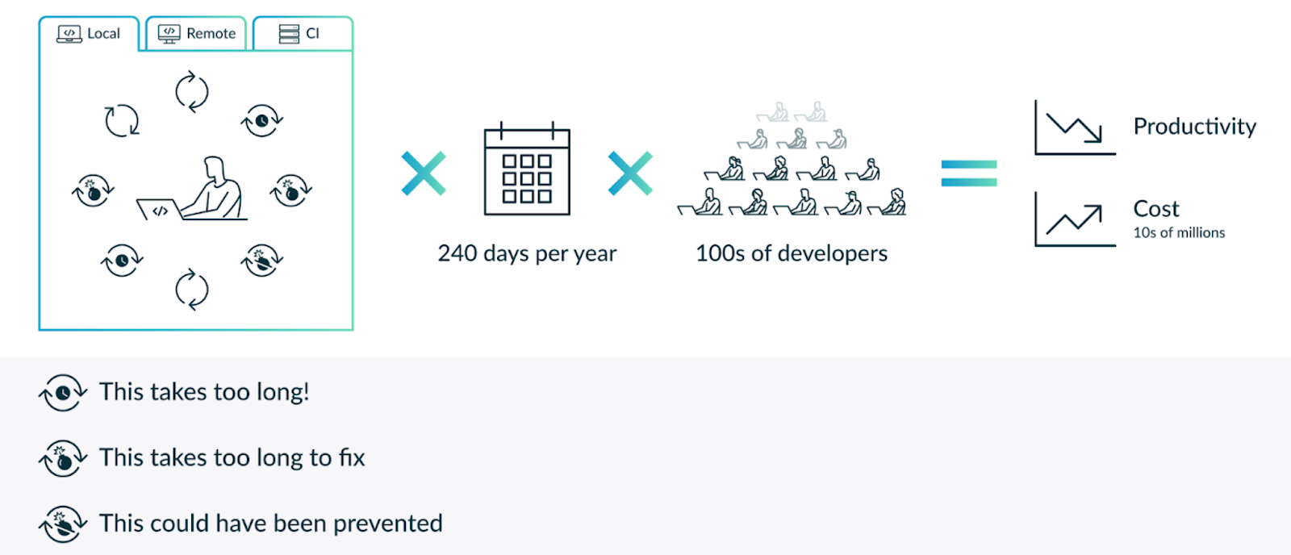
What problem are we trying to solve?
Notes:
Let’s talk about the benefits of DPE. The first is faster feedback cycles through build and test acceleration technologies. This means there is less wasted dev idle/wait time, which leads to less context switching and more focused developers because they stay in their creative flow. All of this contributes to step function increases in productivity. Because builds are fast, developers more often and this leads directly to a number of effects you can see in the diagram that result in higher quality code.
The next major benefit is efficient troubleshooting tied to our Build Scan analytics tool which facilitate root cause analysis. The resulting faster MTTR improves productivity and positively impacts quality
More Reliable Builds and Tests enabled by our Failure Analytics capabilities mean the toolchain itself will fail less frequently and this gives developers more confidence in the toolchain, which in turn makes them more likely report problems, seek out toolchain and infrastructure advice, and fix things themselves without needing to reproduce the problem and reflexively getting the build team involved. All of this again translates into faster MTTR, quality and productivity optimization.
Finally Trends & Insights allows dev teams to get out of firefighting mode and look at how overall performance is trending over time. Observability of key performance and failure metrics over time allows proactive detection of anomalies from normal baselines. This can trigger a proactive intervention before a problem becomes an emergency. Observability is also the key to a continuous learning and improvement approach to developer productivity engineering.

Slide 5
Software development is a creative process
Notes:
Software development is a very creative process.It is similar to the creativity of an experimental scientist. Scientists have a hypothesis and then enter a dialogue with nature via experiments on whether the hypothesis is correct. Our hypotheses is our code and the dialogue is with the compiler, unit, integration, performance tests, other validations and interacting directly with the running software. So our creativity requires a dialogue.
The quality of the creative flow for your developers depends on how functional that dialogue is In an ideal world you get the answers instantaneously, the answers are always correct and your changes are immediately available at runtime.

Slide 6

Notes:
This was more or less the experience when we all started with software development. This was so much fun, it was so productive and we got hooked on it.
Please ask yourself that question. When you wrote your first code and it would have taken 1 minute waiting time to change the color of the circle your were drawing, would you have continued with coding?

Slide 7
Enterprise Software Development is creating a unique set of challenges
Notes:
Now we are enterprise software developers, we are operating at scale with code that builds in some cases hundreds of thousands of times a day

Slide 8
Project success negatively impacts toolchain efficiency
In successful projects all those metrics are growing, often exponentially:
Lines of Code
No. of developers
No. of repositories
No. of dependencies
Diversity of tech stack
Result:
Toolchain efficiency severely degrades if unmanaged
The return of growing the team becomes more and more marginal
Notes:
What do those metrics have in common in successful software projects?
They are growing. They are growing often exponentially.

Slide 9
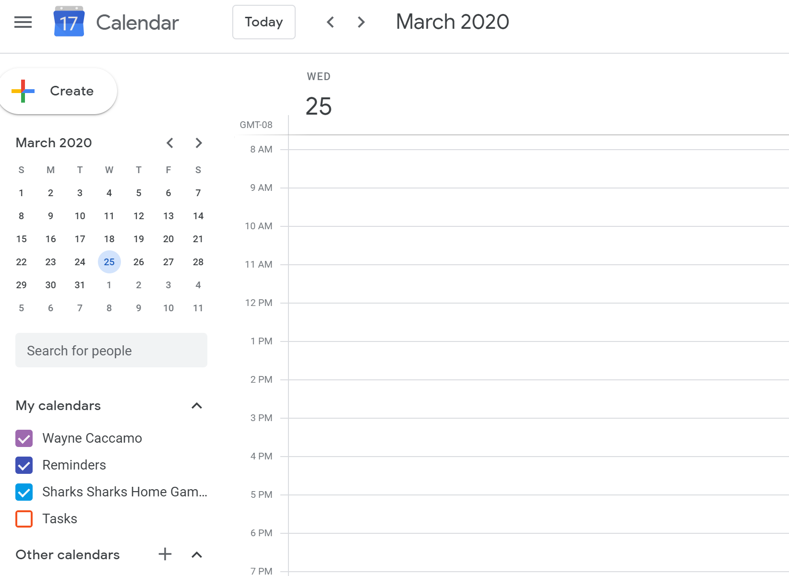
A Day in the Life of Enterprise Developers
Code
Code
DPE Outcome
Give developers hours back in their week to work on valuable solutions
Wait Time for Local Build
Debug Build Failure
Lunch/Ping Pong
Code
Wait Time for Local Build
Sprint
Waiting time for CI Build
Investigate/Fix Flaky Tests
Notes:
Think of what they could do with that time…

Slide 10

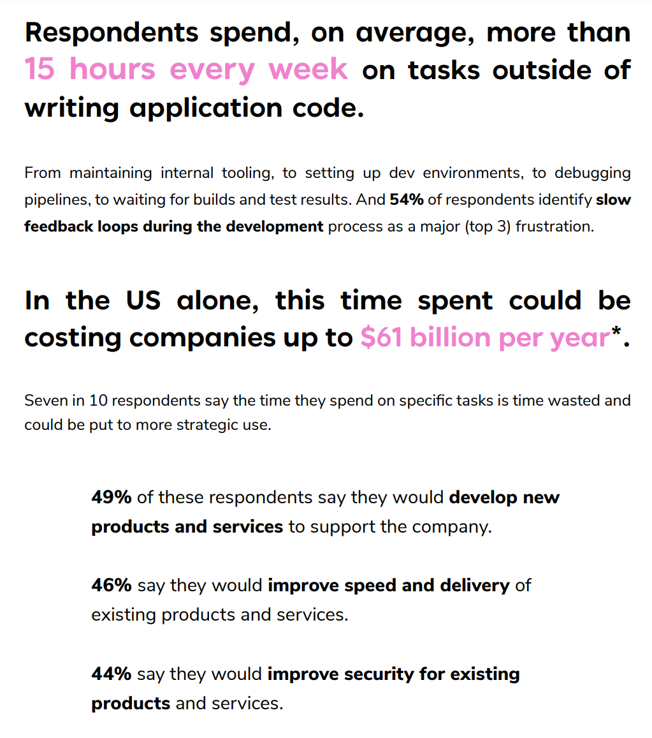

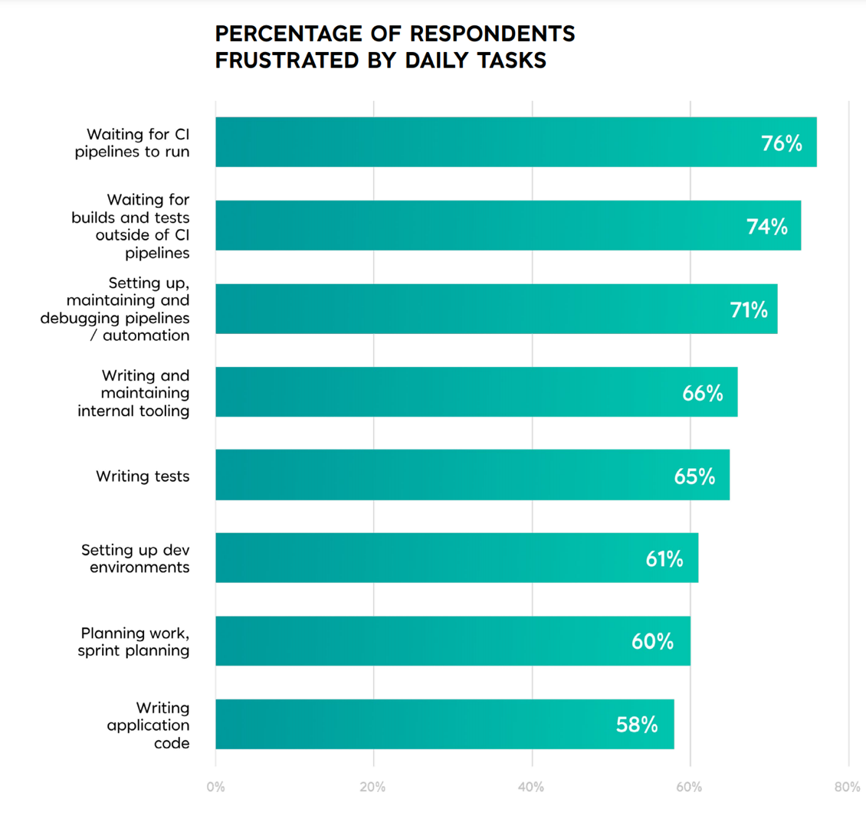
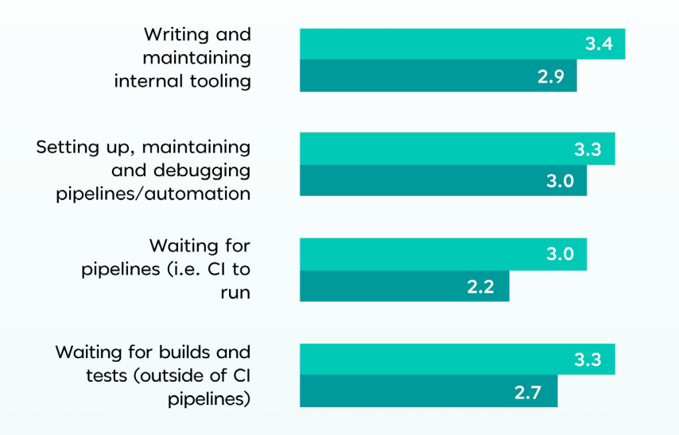




Slide 11
Teams work far from their true potential
Developer Productivity affects Developer Happiness
Low Developer Productivity is blocking
business innovations

Slide 12

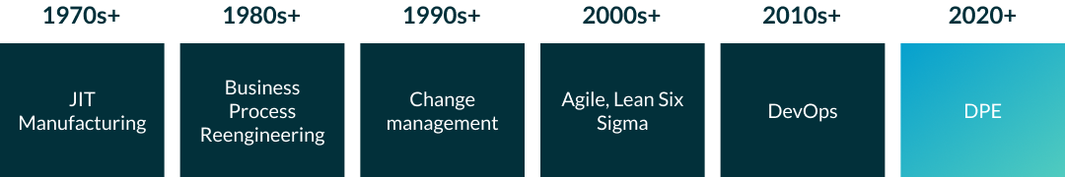
What comes after DevOps?

Slide 13

Introducing Developer Productivity Engineering
So, when we say Developer Productivity Engineering is the ‘next thing,’ we mean that literally
Using acceleration technologies and data accumulation and analysis technologies, DPE addresses the next set of bottlenecks in software productivity
Friction and slowdowns in the developer experience, caused by unreliable and/or slow build infrastructure represent productivity black holes that are not in scope for DevOps
Notes:
For the compile goal/task the inputs are the source files, the classpath, the java version, compiler configuration.
The output are the compiled classes.
For the test goal/task the inputs are the tet sources, the test runtime classpath, …
The output are the test reports
Caching is a generic concept. Compilation, Source code generation, documentation, checkstyle, pmd, … are cacheable.
Let’s look at an example. The famous open source SLF4J logging project.

Slide 14
DPE != DPM

Slide 15
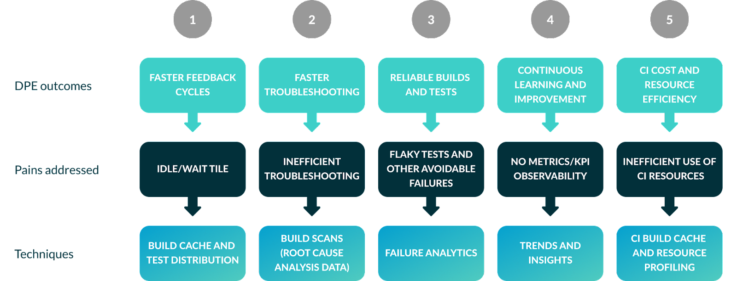
DPE Solution Overview

Slide 16





DPE Solution Breakdown
Build Cache and Test Distribution
Faster feedback cycles by caching build tasks
Parallel test execution, decrease time spent testing
Build Scans
Shareable root cause analysis tool
Full X-ray of build with context
Failure Analytics
View build and test failure rates and history
Find flaky tests and unreliable build infrastructure
Trends and Insights
Spot inefficiencies and outliers
Gauge success of initiatives
CI Cache and Resource Profiling
Speed up CI builds
Determine causes of stress on CI environments

Slide 17
Very fast feedback cycles are important
Blank background use at will

Slide 18
Faster builds improve the creative flow
 | Team 1 | Team 2
No. of Devs | 11 | 6
Build Time | 4 mins | 1 mins
No. of local builds | 850 | 1010
The faster the feedback is, the more often devs ask for feedback
The more often they ask for feedback, the more they can refine their work

Slide 19
Builds that are faster than 10 mins cause significant waiting time
Slower builds means developers are often context-switching while build and tests finish
The aggregated cost of waiting is surprisingly high even for faster cycles
Even moderate improvements are worthwhile at scale to reduce idle time
A unreliable toolchain substantially increases waiting time!
No of devs | Local builds per week | Build Time | Build Time w. GE | Savings per year
6 | 1010 | 1 mins | 0.6 mins | 44 days
100 | 12000 | 9 mins | 5 mins | 5200 days

Slide 20
Build caching is a tool for very fast feedback cycles
Blank background use at will

Slide 21

Build Caching
Introduced to the Java world by Gradle in 2017.
Available for Maven and Gradle, can support both user local and remote caching for distributed teams
Build caches are complementary to dependency caches, not mutually exclusive:
A dependency cache caches fully compiled dependencies
A build cache accelerates building a single source repository
A build cache caches build actions (e.g. Gradle tasks or Maven goals)
Notes:
For the compile goal/task the inputs are the source files, the classpath, the java version, compiler configuration.
The output are the compiled classes.
For the test goal/task the inputs are the tet sources, the test runtime classpath, …
The output are the test reports
Caching is a generic concept. Compilation, Source code generation, documentation, checkstyle, pmd, … are cacheable.
Let’s look at an example. The famous open source SLF4J logging project.

Slide 22
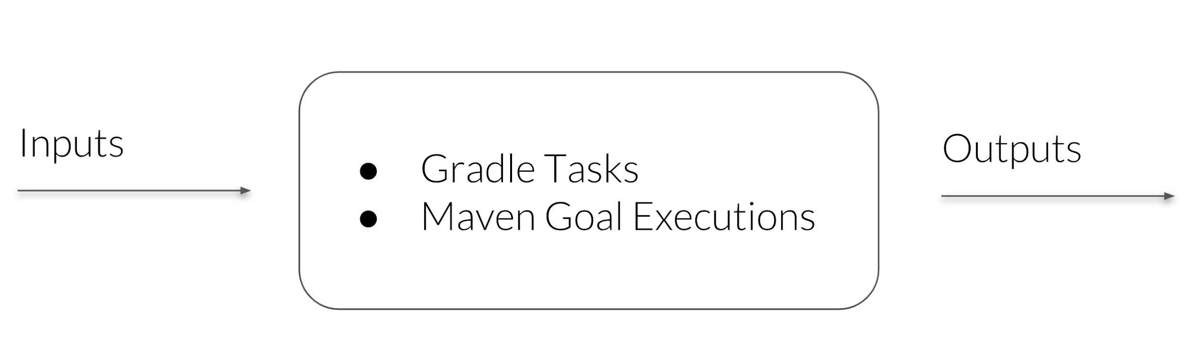
Build Caching
When the inputs have not changed, the outputs can be reused from a previous run.
Notes:
One technique for speeding up feedback cycles is to use a build cache. There’s no reason to waste CPU cycles, and more importantly, your time, building something you’ve built before. Gradle tasks and Maven goals know their inputs and outputs. Their inputs are typically the files they read and their outputs are the files they write.
So a build cache is a key value store where the keys are hashes calculated from a task’s inputs and the values are the outputs. When the inputs haven’t changed the outputs can be reused from the cache and compilation, and other cacheable tasks or goals, can be skipped entirely.

Slide 23
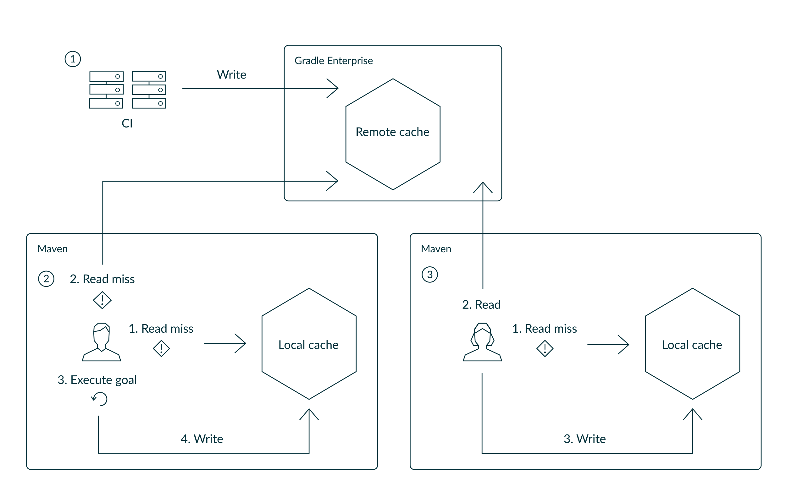
Local & Remote Caching
Notes:
There are multiple levels of caches. Extremely important for Maven is the local cache. In Maven you mostly run clean builds because otherwise the builds are not reliable. So when you have a 20, 50 or 100’s of submodules project and you change only one LOC with the build cache this clean build becomes very often very fast because most of the output does not need to be rebuild but retrieved from the cache.
The remote cache allows build output to be shared between machines, for example between CI machines or CI machines and developer machines. A huge accelerator for CI and developer builds to be able to reuse build output.

Slide 24
Measurements with OSS Projects
When running mvn clean verify
Project | uncached | fully cached
Apache Commons IO | 01:23 min | 00:04 min
Google Guava | 07:19 min | 01:00 min
Spring Boot | 21:31 min | 06:53 min
Apache TomEE | 1h 27min | 20 min
Notes:
There are multiple levels of caches. Extremely important for Maven is the local cache. In Maven you mostly run clean builds because otherwise the builds are not reliable. So when you have a 20, 50 or 100’s of submodules project and you change only one LOC with the build cache this clean build becomes very often very fast because most of the output does not need to be rebuild but retrieved from the cache.
The remote cache allows build output to be shared between machines, for example between CI machines or CI machines and developer machines. A huge accelerator for CI and developer builds to be able to reuse build output.

Slide 25

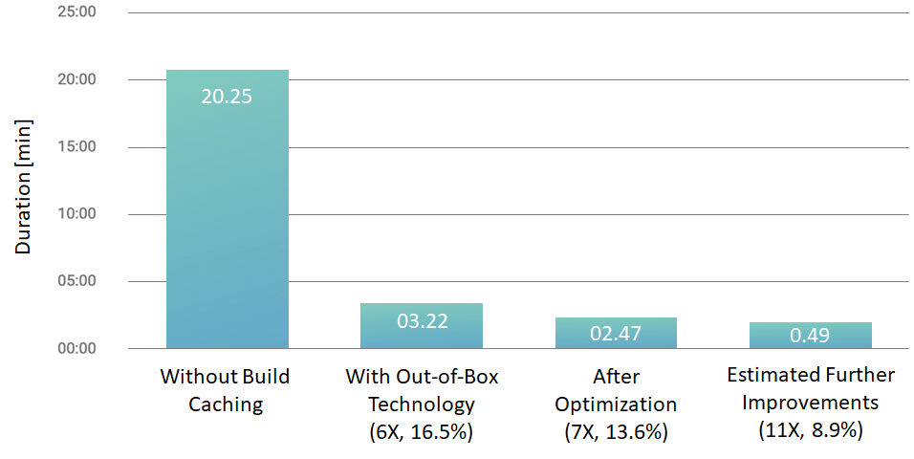
Spring Boot Build Time for Compile & Unit Tests
View Spring’s Results:
https://ge.spring.io
Notes:
Let’s look at a more sizable project. It is the actual Spring Boot project itself. It has 270K of codes and a lot of unit tests. It has 86 subprojects.
Compiling and running the unit tests with plain Maven takes 20:25min. With DPE optimizations, out of the box, without touching anything in the Spring Boot project, the build time when fully cached goes down by a factor of 6 or to 16.5% of the original build time. With some optimization to the configuration of the build it goes by a factor of 7. With the next release of GE we will get it down by an order of magnitude by making more goals cacheable.

Slide 26

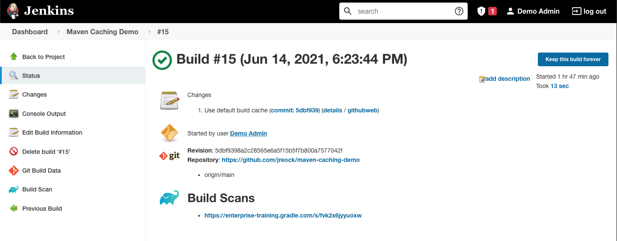
Demo: Speeding up Local and CI Builds with a Build Cache
Demonstrate local Maven build caching
Update the configuration to use a remote build cache
Deploy the code into Jenkins
Trigger a build, and note the use of the remote build cache
Notes:
Demonsbrew services start jenkins-lts

Slide 27
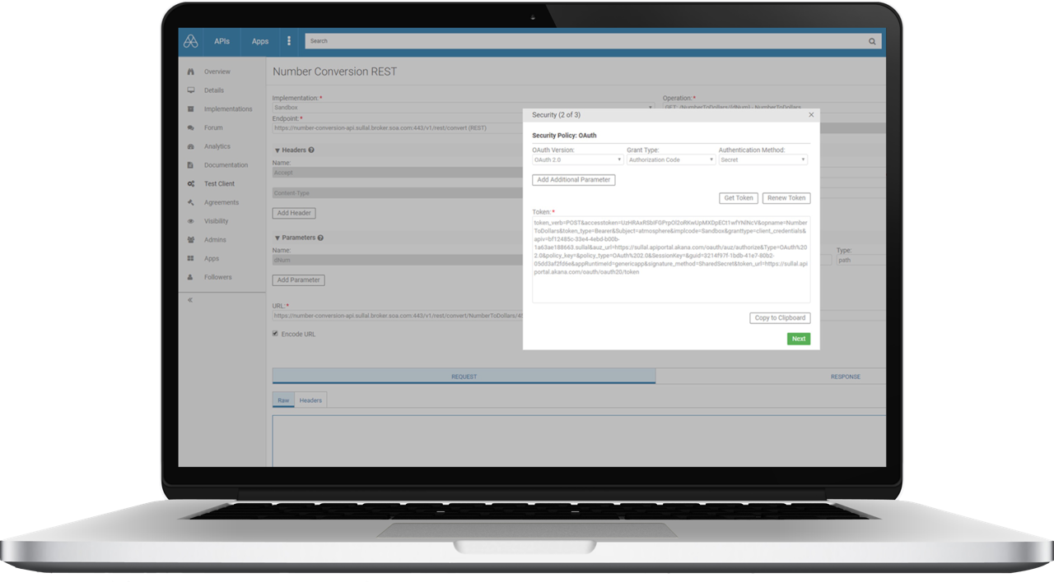
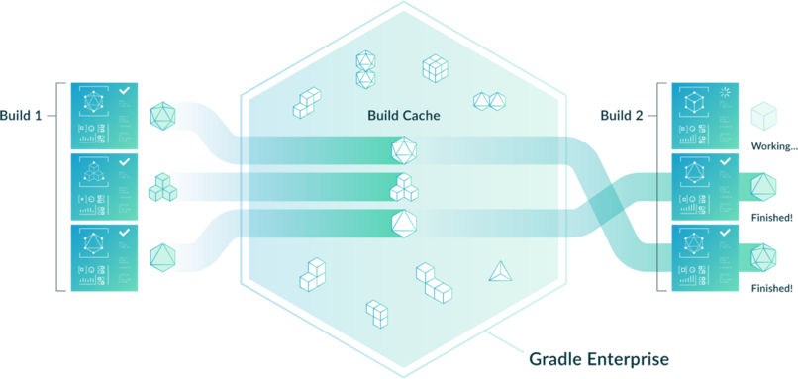

Test Distribution – Move Even Faster
Test distribution allows us to execute multiple stateless tests at once in parallel, reducing the time spent waiting on test feedback
Tests can be horizontally distributed across a pool of test agents
Hans gives an excellent overview of the Apache Cassandra project’s success implementing:
https://tv.gradle.com/intro-distributed-testing
Notes:
Again full attribution would be available if I had the G2 login

Slide 28
“What gets measured gets improved.”
- Attribution debated
Blank background use at will

Slide 29
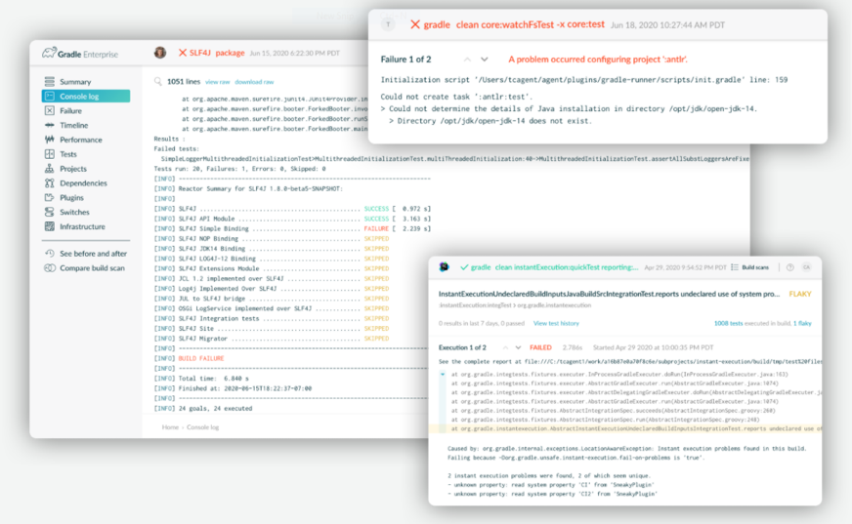
Build Scans
Build scans provide a comprehensive, shareable summary on performance, dependencies, failures, test executions, and more
It’s easy to spot bugs and failures, and is self-service to the developer
Developers can share build details with context
Scans can run against Maven builds by adding a free extension
“Perhaps the best part of using the Gradle Build Scan is that it provides direct links to the relevant parts of the official documentation from Gradle which are more of the Friendly Manual kind.”
–Jean-Michael Fayard, Writer, Kotlin Academy

Slide 30
Setting Up a Build Scan (and cache!)
Maven .mvn/extensions.xml
<extensions>
<extension>
<groupId>com.gradle</groupId>
<artifactId>gradle-enterprise-maven-extension</artifactId>
<version>1.10.5</version>
</extension>
</extensions>
Gradle gradle.properties
Gradle Enterprise
.mvn/gradle-enterprise.xml
org.gradle.caching=true
<gradleEnterprise>
<server>
<url>https://gradle-enterprise.server/</url>
</server>
</gradleEnterprise>
Gradle CLI
Notes:
here are multiple levels of caches. Extremely important for Maven is the local cache. In Maven you mostly run clean builds because otherwise the builds are not reliable. So when you have a 20, 50 or 100’s of submodules project and you change only one LOC with the build cache this clean build becomes very often very fast because most of the output does not need to be rebuild but retrieved from the cache.
The remote cache allows build output to be shared between machines, for example between CI machines or CI machines and developer machines. A huge accelerator for CI and developer builds to be able to reuse build output.

Slide 31
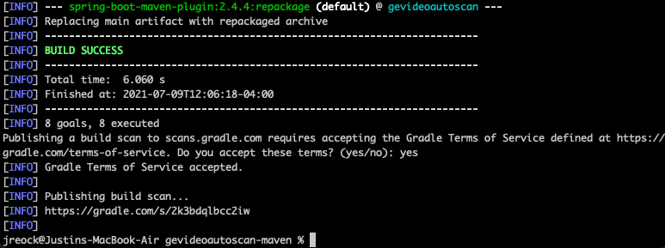
Demo: Local Maven Build Scan
Generate the camel-archetype-spring-boot Maven archetype
Enable the Gradle Enterprise Maven extension plugin and run the build
Observe the Build Scan results
Also demonstrate native Gradle build scan with “gradle build --scan”
Notes:
mvn archetype:generate
-DarchetypeGroupId=org.apache.camel.archetypes
-DarchetypeArtifactId=camel-archetype-spring-boot
<extensions>
<extension>
<groupId>com.gradle</groupId>
<artifactId>gradle-enterprise-maven-extension</artifactId>
<version>1.10.5</version>
</extension>
</extensions>
[be sure to nuke .m2/.gradle-enterprise if first run]
mvn clean verify

Slide 32
Why data is essential to keep builds fast
Blank background use at will

Slide 33

Performance regressions are easily introduced
Infrastructure changes
Binary management
Caching
CI agents
New annotation processors or versions of annotation processors
Build logic configurations settings
Build tool version and plugins
Compiler settings
Memory settings
Code refactoring
New office locations

Slide 34
Observability = Effectiveness

Slide 35
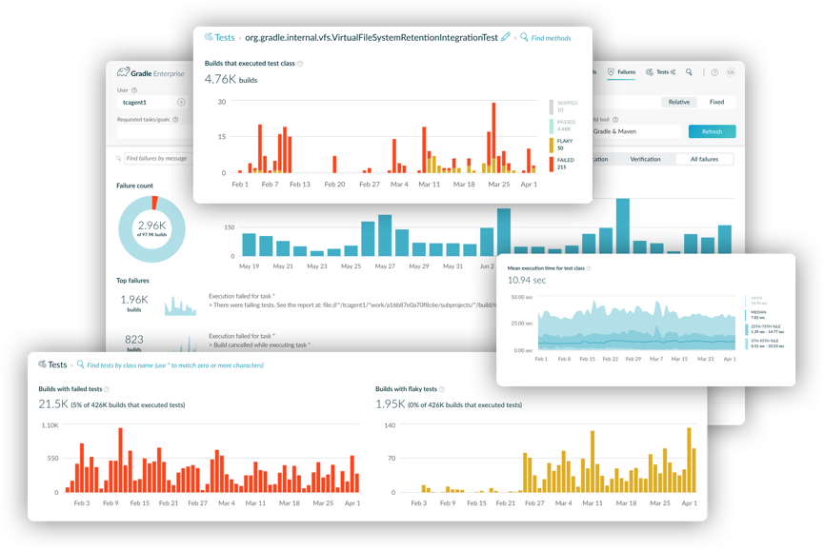
Trends and Insights
DPE PMO should centralize build metrics
They can be used to benchmark and ensure productivity improvement
This enables the DPE PMO to continually improve productivity
Build feedback is automatically provided to the DPE PMO team each build
“How does a project get to be a year late? One day at a time.”
-Fred Brooks, Renowned Software Engineer, IBM
Notes:
ENSURE ROI by tracking through the DPE PMO team

Slide 36
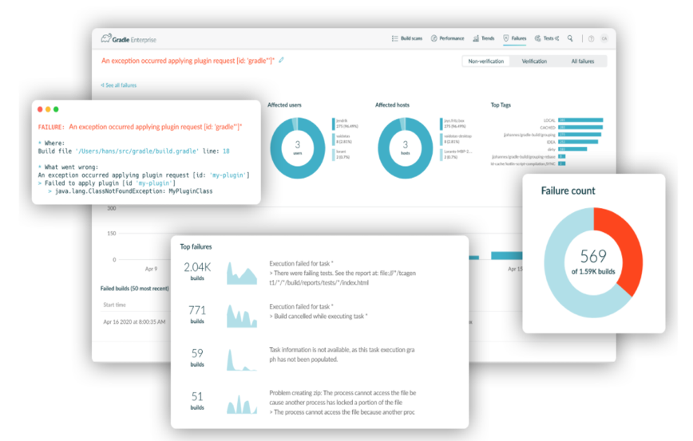
Failure Analytics
Test and build results can be compared across runs to identify non-deterministic (flaky) behavior
By finding flakiness further left, we reduce the number of bugs that make it past the debugging phase
By pinpointing the source of failure, we can significantly reduce time spent troubleshooting builds
“If you can’t measure it, you can’t improve it.”
- Peter Drucker, Business Luminary
Notes:
Could get a logo here if I had access to your G2!

Slide 37
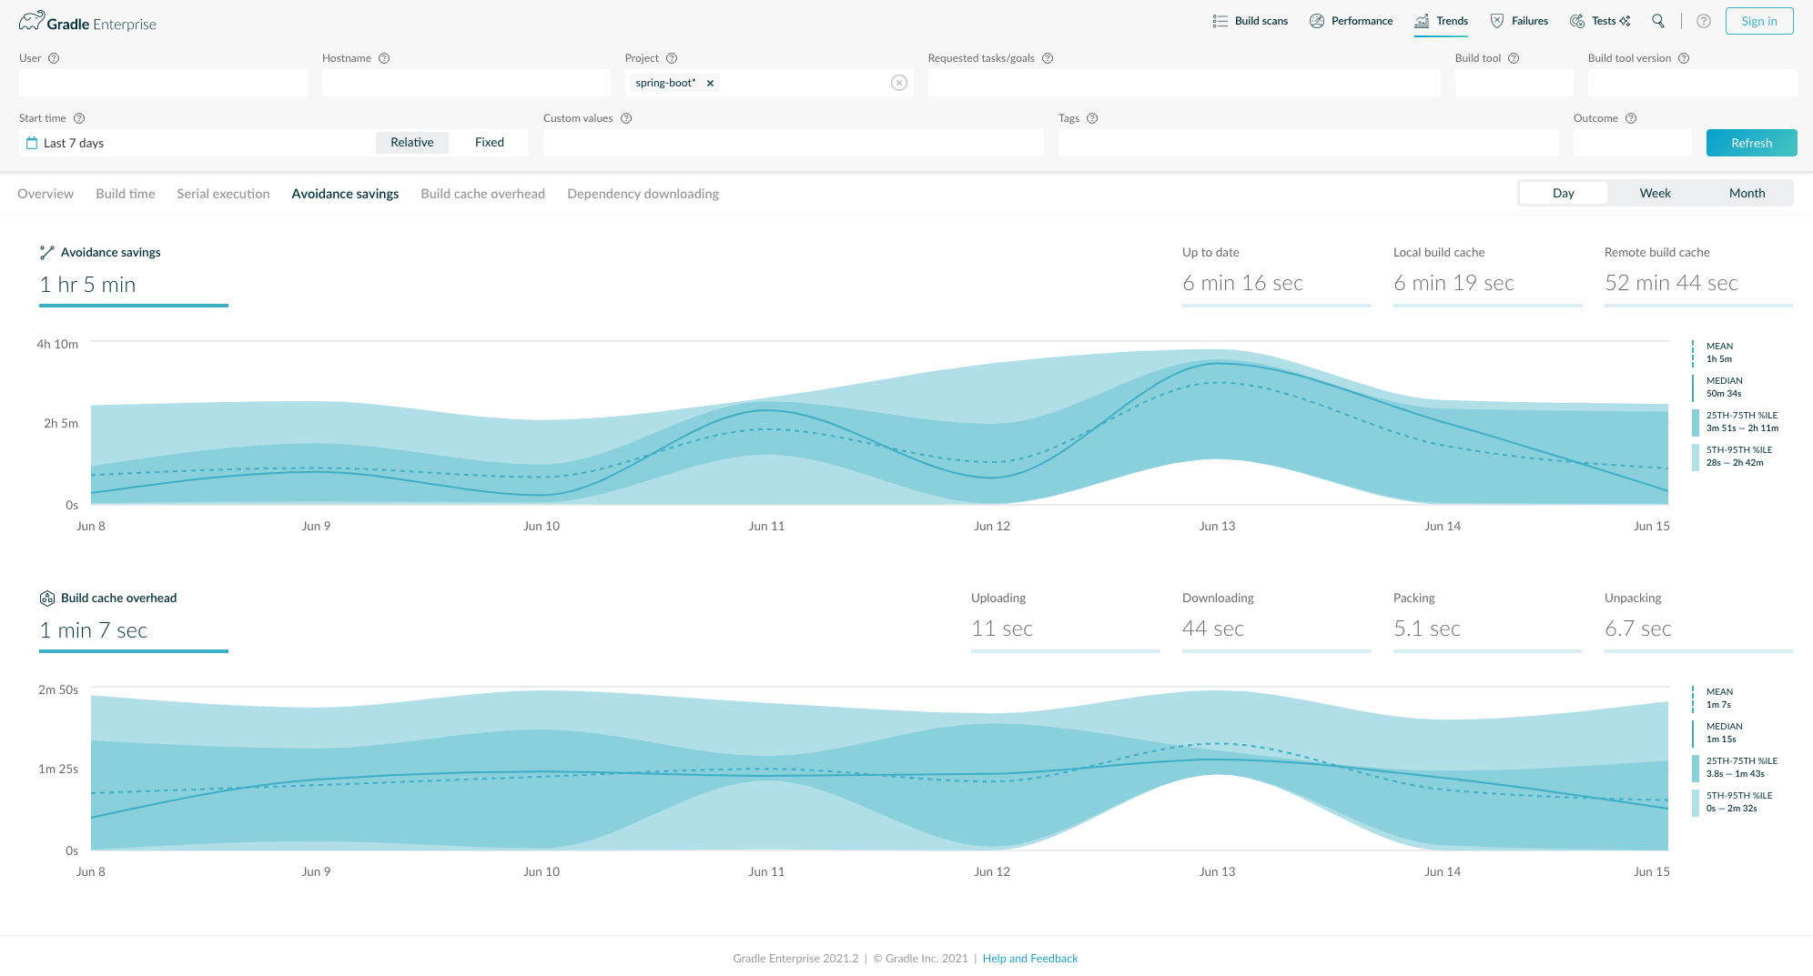
Demo: Spring’s DPE Dashboard
Visit https://ge.spring.io
Explore the Trends and Insights as well as Failure Analytics section
Notes:
brew services start jenkins-lts

Slide 38
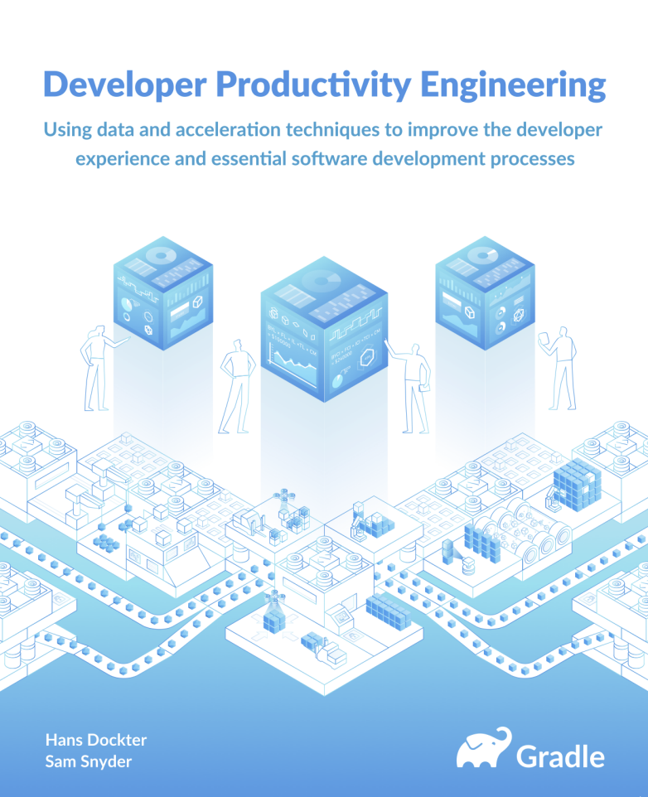

Slide 39

Next Steps:
Try a free Maven or Gradle Build Scan! (Hint: Just enable the Maven extension or run ’gradle build –scan’)
Check out the Gradle Enterprise docs: https://docs.gradle.com/
Read about Build Scans and Build Comparisons: https://gradle.com/gradle-enterprise-solution- overview/build-scan-root-cause-analysis-data/
Q&A

Slide 40


jreock@gradle.com
Thank you!

